Slide 1
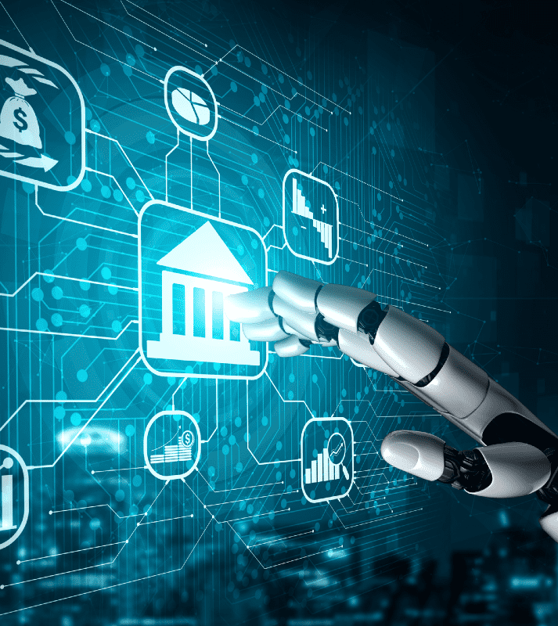
CS-591 Machine Learning and Soft Computing Marketing Campaign Predictor
By:
Wasimuddin fathimullah 856530878
Taif Al Beedh 856519747

Slide 2

Introduction
Banks tend to do marketing in various ways such as
direct marketing
media marketing
word of mouth
Advertisements
social media promotions etcetera
amongst all the ways direct marketing is the only path where human labor is required
Bank employees must directly contact each one of their customers to enquire their interests in a particular scheme or term deposit which is a very time taking process .
This is where our machine learning model comes into picture.

Slide 3





















Overview
Time taking and inefficient as a human analyst cannot be perfect
Banks have several tasks on their plate
Advertising, Credit line, loans, accounts etc.
Use their employees and agents
Yes
Employees will only call the clients that are predicted to accept term deposit
No
Marketing Productivity
Bank dataset
Machine Learning Model
Clients pre-approved for loan are contacted and offered loans to increase bank credit line profits
Approved
Project Idea
Loan Status Eligibility
Loan dataset
Merged dataset
Machine Learning Model
Not Eligible for loan
Noise
De-Noise
Data Privacy
Differential Privacy
Data is useless
Data is useable

Slide 4
AIM
The goal of this project is to build a machine learning model that learns the patterns from the several input features related to the details of bank customers in order to classify whether the client will accept a term deposit that was offered by the bank through direct marketing.
In this way, the total number of customers that must be contacted is reduced drastically, giving the employees a way by only calling the potential customers.
On the other hand, build a model that will predict and set a loan status flag showing whether a customer is pre-approved for loans or not.

Slide 5
Dataset Information
Source: Kaggle
Rows: 45211
The selected bank dataset has 16 features
The target column shows a Boolean value Yes/No indicating whether a client might accept the term deposit offered by the bank through direct marketing.
Additionally, for predicting the loan status, another Boolean target is allocated that uses a different dataset.

Slide 6
Features
Client’s age (numerical)
Client’s job (categorical)
Marital status (categorical)
Education (categorical)
Default: does the client has credit in default (binary)
Balance: the average yearly balance in Euros (numerical)
Housing: does the client has a housing loan (binary)
Loan: does the client has a personal loan (binary)
Contact: the communication type (categorical)
Day: the day of the last contact (numerical)
Month: the month of the last contact (categorical)
Duration: the duration of the last contact (numerical)
Campaign: no. of contacts performed for the client during this campaign (numerical)
Pdays: no. of days after the client was last contacted from the last campaign (numerical)
Previous: no. of contacts performed for the client before this campaign (numerical)
Poutcome: the outcome of the previous marketing campaign (categorical)

Slide 7

Dataset Information II
Loan ID: Unique loan ID of customer
Gender: Male/female
Married: Y/N
Dependents: number of dependents
Education status: Graduate/Undergraduate
Applicant Income
Co Applicant Income
Loan Amount: Loan amount in thousands
Loan Amount Term: Term of loan in months
Credit History: if history meets guidelines
Property Area: Urban/Semi-Urban/Rural

Slide 8
Dataset Processing
Both the datasets acquired from Kaggle and firstly checked for any NULL values, so that the rows with null values can be deleted before processing the data.
Then the categorial features such as marital status, Education, Housing, job, contact type are changed to numerical format for the machine learning to compute easily.
For Example: Single -1, Married – 2; Education: Nill-1, Primary-2, Secondary-3, Teritiary-4 etc.
All this data is given into the model for training.
Then, for campaign outcome, the testing data set named as queries.csv is given without the target dataset.
Now, the model gives target output Predictions.txt files which are later updated into the CSV file to include the target columns Predictions.

Slide 9
Project Code
The code can be divided into 3 parts:
Predicting the outcome of the marketing campaign
Predicting loan eligibility using dataset 2
Applying differential privacy on both datasets individually

Slide 10
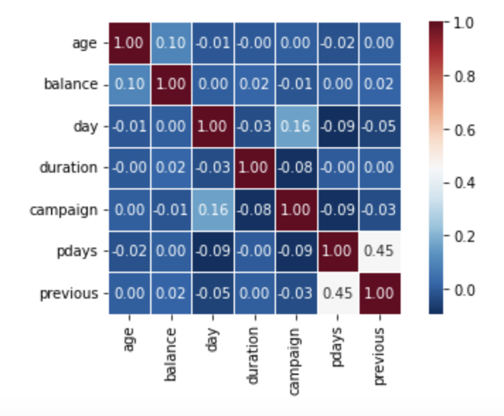
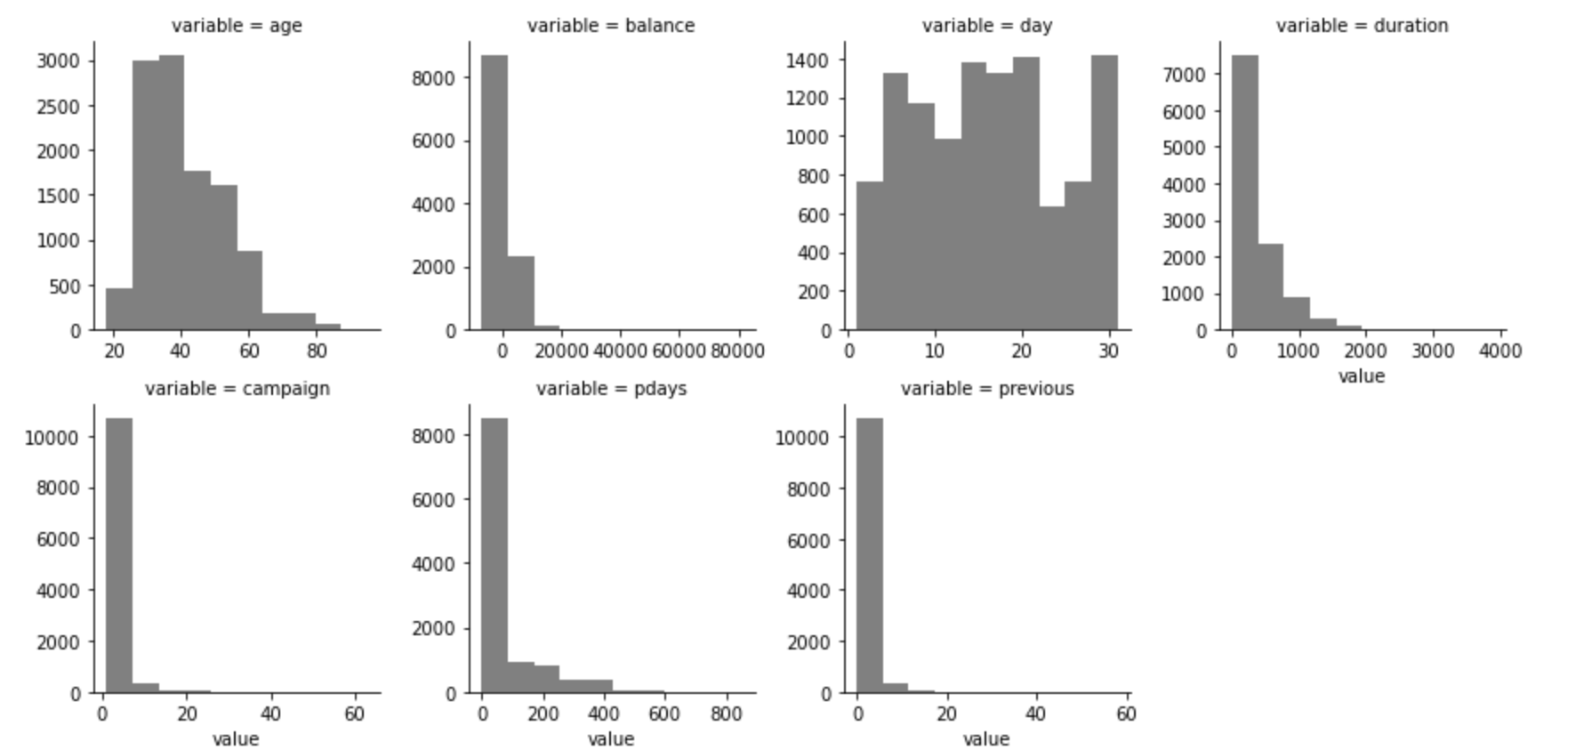
1. Predicting the outcome of the marketing campaign
Data is visualized using histograms and heatmaps
Different classifiers are built for efficiency comparison
Decision tree
K-Nearest Neighbor
Naïve Bayes

Slide 11
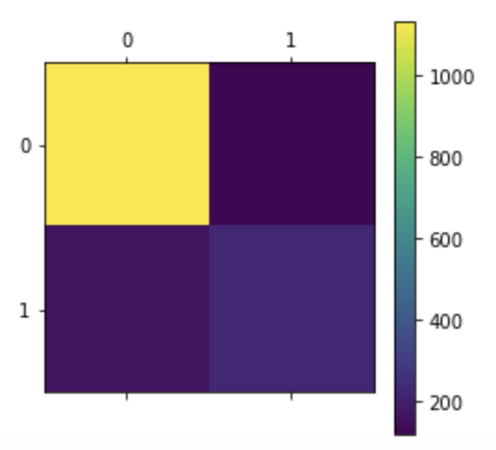
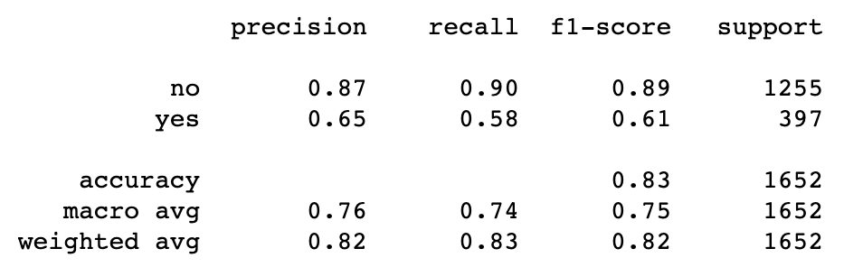
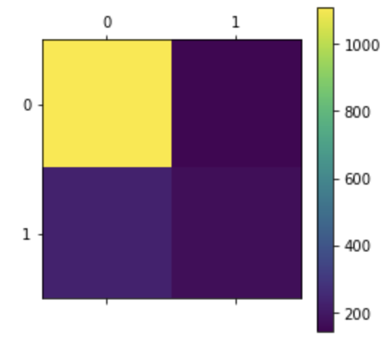
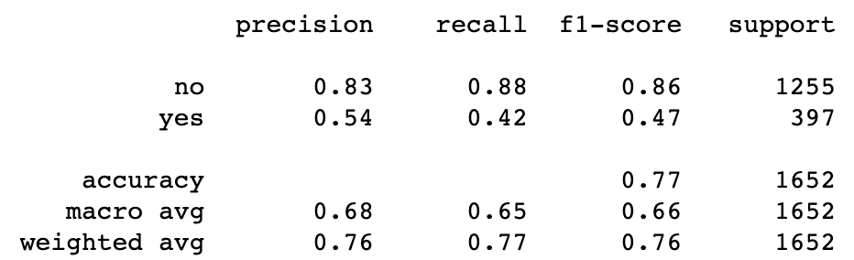
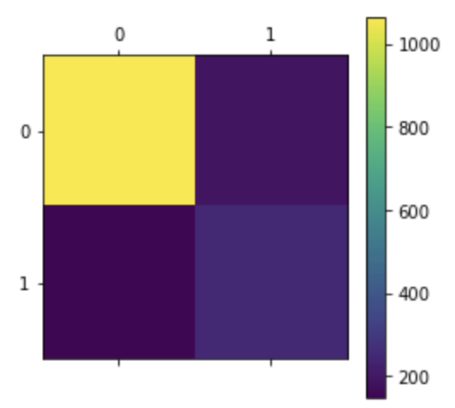
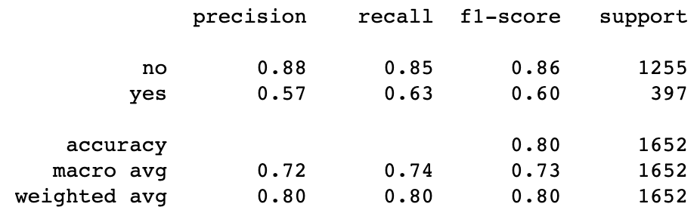
1. Predicting the outcome of the marketing campaign
For each classifier, a confusion matrix and a classification report were generated
The most accurate classifier is chosen for prediction

Slide 12
1. Results
After passing the Queries file that has no target column, the model will predict the marketing campaign result.
A text file is created that has customer ID’s and the predicted results.
The CSV file is updated to include the predictions outcome column.

Slide 13
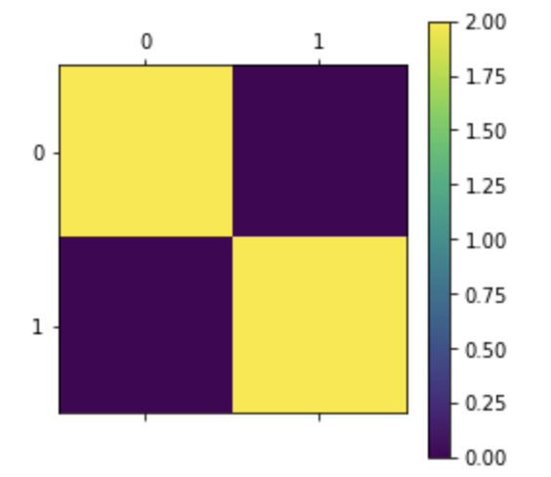
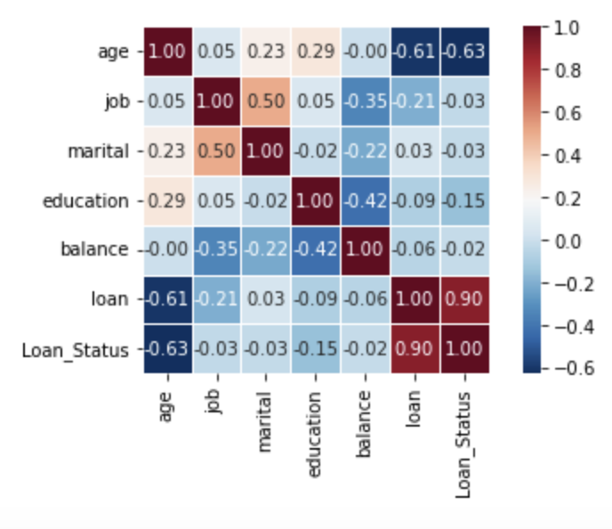
2. Predicting loan eligibility
1. Unnecessary columns from the bank dataset and the loan dataset were dropped
2. Column values in the bank dataset were replaced to match the column values in the loan dataset
3. The columns in the loan dataset were renamed to match the column names in the bank dataset
4. Both datasets were merged using common columns
5. Missing values were removed
6. LabelEncoder was used
7. A confusion matrix and a heatmap were generated

Slide 14
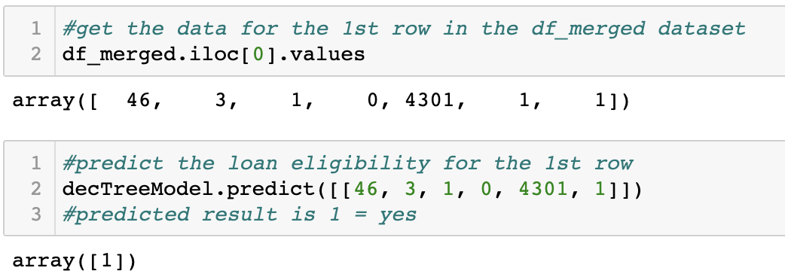
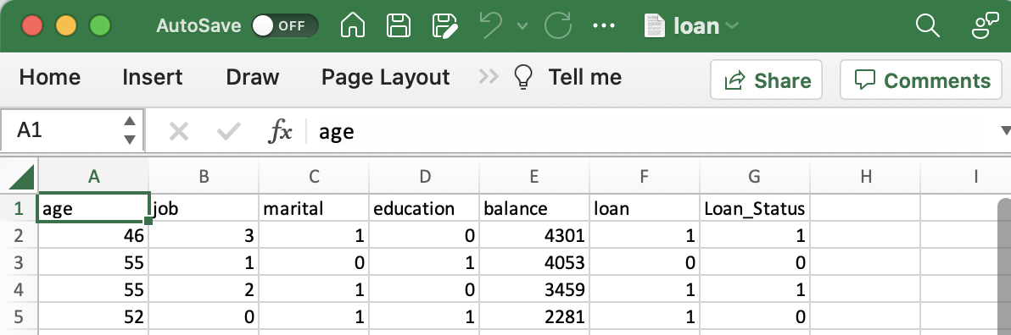
2. Results
Predict loan eligibility
CSV file is created and has the loan eligibility status of given customers

Slide 15
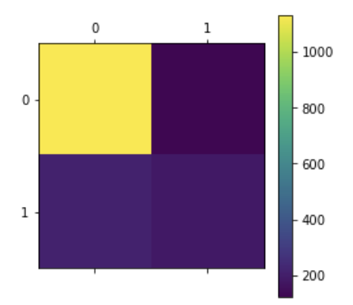
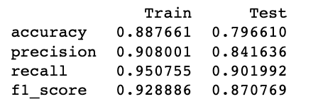
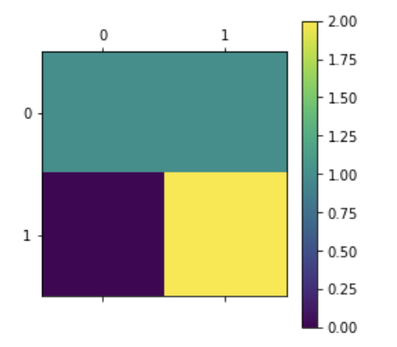
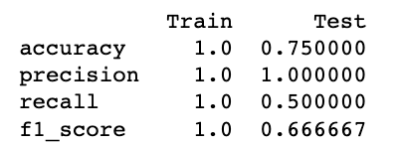
3. Differential Privacy
As we are working with a banking dataset, all the data is personal, sensitive, and can be misused. Hence, we are using differential privacy to distort the data, which even if leaked will not be valid data. This is achieved by adding noise to the dataset
Predict the outcome of both datasets before adding noise
Drop target columns from both datasets
Add noise to both datasets
Return the target columns to the bank dataset and loan dataset
Predict the outcome for both the bank dataset and loan dataset

Slide 16
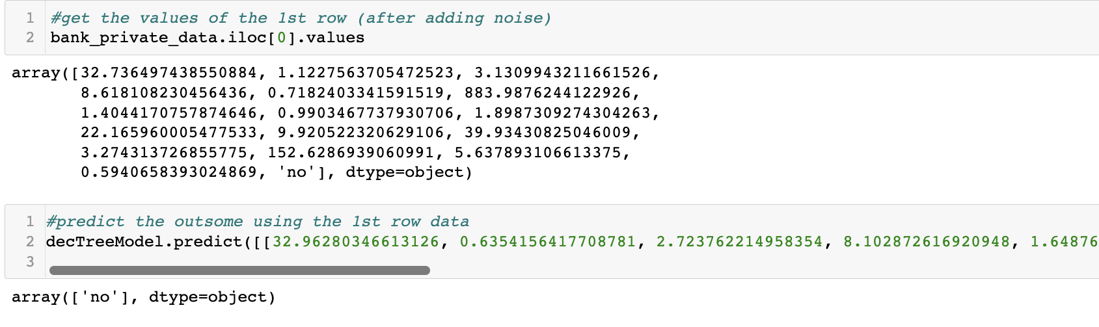
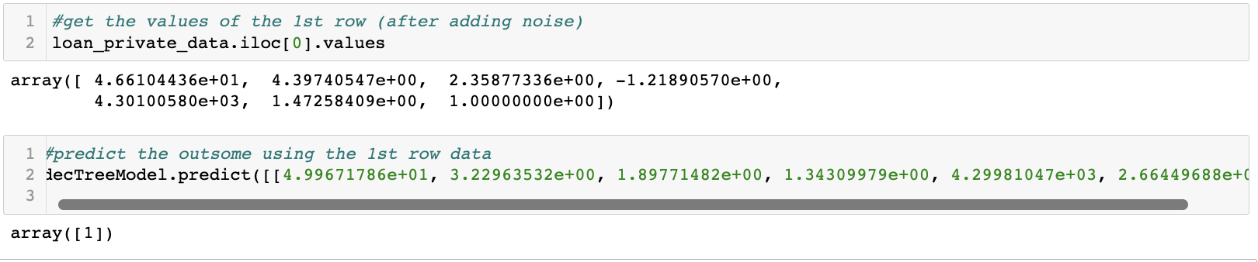
3. Results
Predicting the marketing campaign outcome
Predicting the loan eligibility

Slide 17
References
[Moro et al., 2014] S. Moro, P. Cortez and P. Rita. A Data-Driven Approach to Predict the Success of Bank Telemarketing. Decision Support Systems, Elsevier, 62:22-31, June 2014
https://archive.ics.uci.edu/ml/datasets/bank+marketing
M. A. Sheikh, A. K. Goel and T. Kumar, "An Approach for Prediction of Loan Approval using Machine Learning Algorithm," 2020 International Conference on Electronics and Sustainable Communication Systems (ICESC), 2020, pp. 490-494, doi: 10.1109/ICESC48915.2020.9155614.
Prateek Dutta, “A Study on Machine Learning Algorithm for Enhancement of Loan Prediction”, “International Research Journal of Modernization in Engineering Technology and Science”, Volume -3 issue-1, January 2021.
http://en.wikipedia.org/wiki/Direct_marketing. Wikipedia has a tool to generate citations for particular articles related to direct marketing.
Ładyżyński, Piotr, Kamil Żbikowski, and Piotr Gawrysiak. "Direct marketing campaigns in retail banking with the use of deep learning and random forests." Expert Systems with Applications 134 (2019): 28-35.
Rosset Saharon, Einat Neumann, Uri Eick, Nurit Vatnik, and Izhak Idan. "Evaluation of prediction models for marketing campaigns." In Proceedings of the seventh ACM SIGKDD international conference on Knowledge discovery and data mining, pp. 456-461. 2001.
Shah, Neil, Sarth Engineer, Nandish Bhagat, Hirwa Chauhan, and Manan Shah. "Research trends on the usage of machine learning and artificial intelligence in advertising." Augmented Human Research 5, no. 1 (2020): 1-15.
www.kaggle.com/datasets/vikasukani/loan-eligible-dataset?resource =download&select=loan-train.csv
Abadi, Martin, Andy Chu, Ian Goodfellow, H. Brendan McMahan, Ilya Mironov, Kunal Talwar, and Li Zhang. "Deep learning with differential privacy." In Proceedings of the 2016 ACM SIGSAC conference on computer and communications security, pp. 308-318. 2016.

Slide 18


